Slide 1


Slide 2
Product Concept

Slide 3
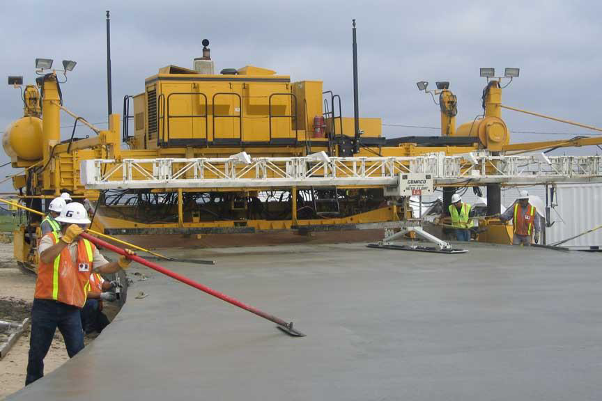
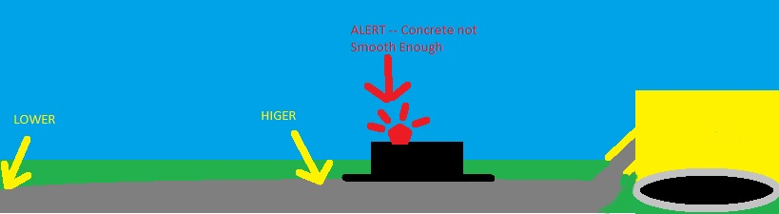
Rear view of a typical paver
Notes:
Lloyd

Slide 4
Product Definition
The Sliding Profiler is a wet concrete bump detection product that aggregates data from many sensors to determine the probable smoothness of the freshly laid road. Before the concrete has dried, the operators will know if the concrete has met the state requirement for smoothness of concrete roads.

Slide 5
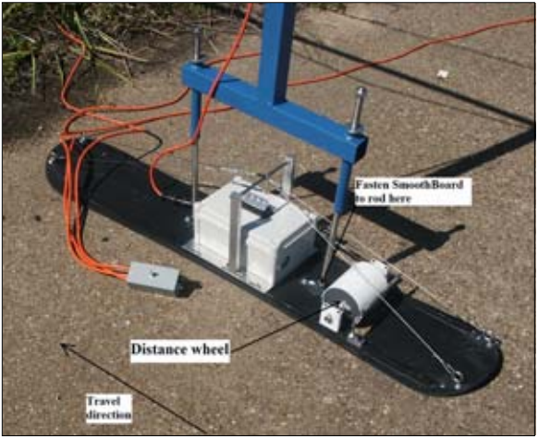
Previous Product

Slide 6
Functional Requirements

Slide 7
Key Critical Requirements
The device shall not operate after a critical error
The device shall be able to measure the travel distance of the platform
The device shall be able to measure the inclination of the platform from a calibration point
The device shall generate operational data from the raw data of the sensors
The device shall detect bumps in concrete pavement while the product is floating on the freshly poured concrete surface
The device shall be able to operate in extreme temperatures
The client application shall calibrate sensors
The client application shall configure the PIC microcontroller
The product shall visually indicate a bump using a beacon light
The product shall be light enough to float on top of the concrete pavement
The product shall not disturb the wet concrete
The slider shall not accumulate cement

Slide 8
User Interface Requirements

Slide 9
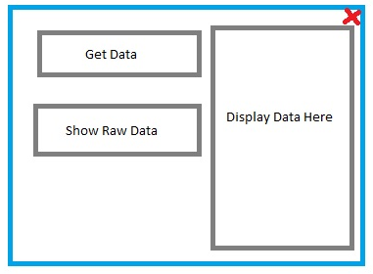
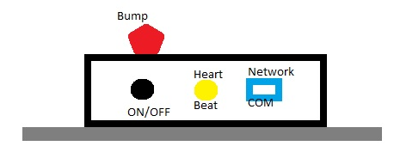
User Interfaces
Client Application
Hardware Interface

Slide 10
UI Requirements
The device must turn on/off easily
The device shall visually indicate error conditions
The device shall visually indicate when it is operating normally
The product shall visually indicate a bump using a beacon light
The client application must run on a PC
The client application shall display operational data
The product shall have a user-friendly client application

Slide 11
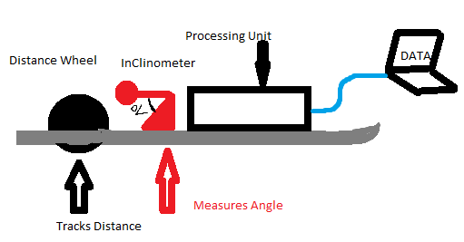
Inputs and Outputs
ITEM | Description | Use | Input or Output
ON/OFF | Turns on and off | Turns on and off | INPUT
Client Application | Software Application | View analyzed and processed data | OUTPUT
Warning Light | A bright flash able light | Notify a bump is detected | OUTPUT
Heart Beat | A soft flashing light | Notify continuous operation | OUTPUT

Slide 12
Packaging Requirements
The Sliding Profiler shall arrive completely assembled
Software shall be customer installable
The product shall come with a storage solution
Notes:
The storage box prevents the Product from outside hazards. Also, the storage solution helps the product to be transported easily.

Slide 13
Performance Requirements
The device shall perform in real-time
The device power source shall be provided externally
The product shall not disturb the wet concrete
The slider shall not accumulate cement
The system shall store operational data
The stored data shall be accessible by user
The product shall operate in extreme temperatures
The client application shall calibrate sensors

Slide 14
Other Requirements

Slide 15
Safety Requirements
The product shall have a power source interruption
The product shall have no sharp edges
The product shall have an electric shock protection

Slide 16
Maintenance and Support Requirements
The product shall be easy to clean
The product shall be returned to the supplier after a critical malfunction
The product shall come with a support manual

Slide 17
Acceptance Criteria
Before the Sliding Profiler can be fully accepted, each feature and function required by the sponsor must be demonstrated and or inspected.
Example: Verify the device visually signals when a bump is detected by light
Verification Procedure: The sponsor will verify the device signals by light when a bump is detected through a live demonstration under a controlled environment to produce a specific result.

Slide 18
Use Cases

Slide 19
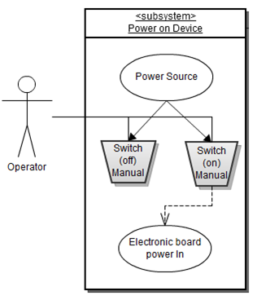

Slide 20
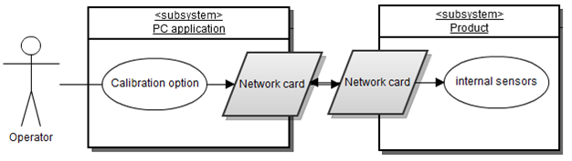
Calibrating Sensors

Slide 21
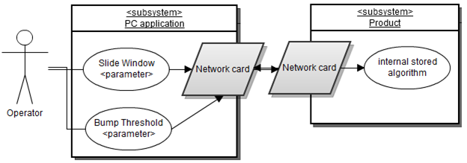
Configure Product

Slide 22
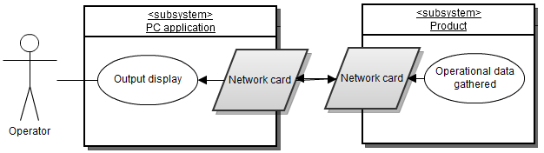
Data Retrieval

Slide 23
Feasibility Assessment

Slide 24
Scope Analysis
Scope Analysis: The scope of work for all critical requirements is reasonable, and prototyping of these by the deadline date appears feasible.

Slide 25
Research
Looked at two previous projects on Sliding Profilers. Our sponsor, Dr. Walker, pointed out their mistakes.
Bump detection algorithm
Weight to surface area ratio
Data acquisition and SP program procedure
SP data server and client module

Slide 26
Technical Analysis
Client application
Hardware design
Mechanical design of the platform
Server-Client communications
Algorithms

Slide 27
Cost Analysis
Components | Low Price ($) | High Price ($)
Inclinometer | 0 | 900
Temperature Sensors | 0 | 5
Encoder | 0 | 5
Microcontroller Unit | 0 | 5
A/D Convertor | 0 | 250
GPS | 40 | 100
PCB + RS232 Interface | 15 | 35
Network chip | 10 | 45
SD Card | 3 | 20
Enclosure | 0 | 50
Platform | 40 | 150
Distance Wheel | 0 | 20
PC Client | 0 | 250
Total | 108 | 1515
* These costs include the option of re-using parts from previous project

Slide 28
Resource Analysis
Team Structure
Two CpE and two CS students
Resource Allocation
Hardware Design - Two CpE
Algorithms - Two CS
Client Application - All Members
Server-Client Application - All Members
Platform Design - All Members + Sponsor

Slide 29
Schedule Analysis
Comparison of various estimation methods
Aggressive Conservative
Size and Productivity 6 months 8 months
McConnell Tables 7 months 9 months
Rule of Thumb 8 months 9 months
CoCoMo 8 months 9 months
Function Points/Jones’s Not Used
Sanity Test (Weiss & Wysocki, 1992)
E = (O + 4M + P) / 6, where O = optimistic, M = Nominal, P = Pessimistic
Therefore, our E = (6 + 32 + 9) / 6 = 47/6 = 7.8 months

Slide 30
Other Customer Requirements

Slide 31
High Priority Requirements
The Device shall be able to measure the internal temperature of the electronics housing.
The Device shall visually indicate when it is operating.
The Device shall visually indicate error conditions.
The Device shall use an embedded PIC microcontroller w/ networking.
Configuration processes shall be obscured from the end-user.
The Device must turn on/off easily.
The Device shall store operational data.
The Product shall have a user-friendly client application.
The client application must run on a PC.

Slide 32
Medium/Low Priority Requirements
The Product shall come with a storage solution.
The Electronics shall be detachable from the Platform.
The Device shall transfer operational data to the client application in real-time.
The client application shall display operational data.
The client application shall read stored data.
The product shall have GPS to track the bump location.

Slide 33
Questions?

